Slide 1
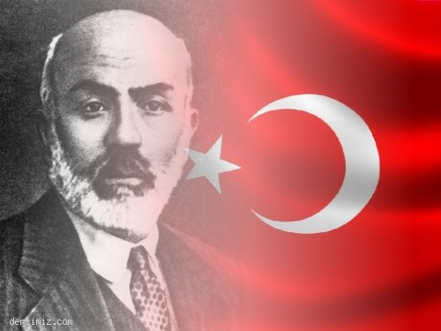

MEHMET AKİF ERSOY
(1873-1936)

Slide 2
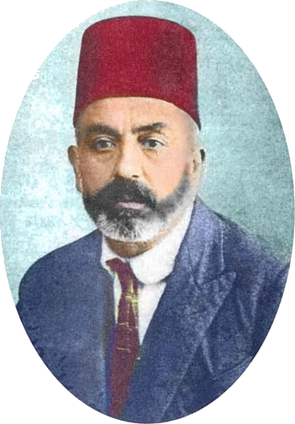
MEHMET AKIF WAS :
HOMELAND POET
VET
TEACHER
KUR’AN TRANSLATOR
SWIMMER
DEPUTY

Slide 3
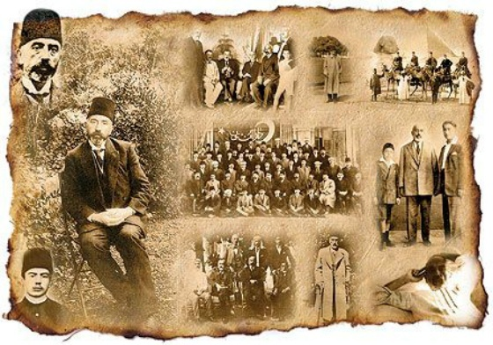
HIS LIFE

Slide 4
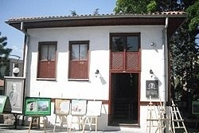
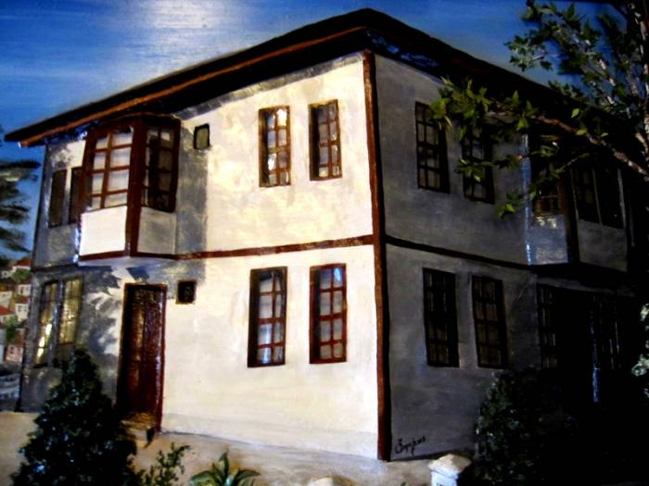
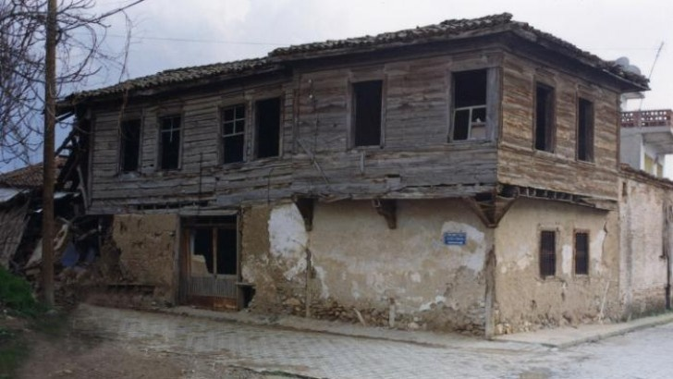
HE WAS BORN ON 20 DECEMBER IN ISTANBUL.

Slide 5
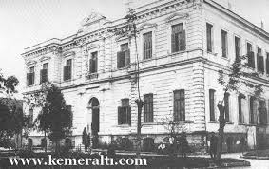
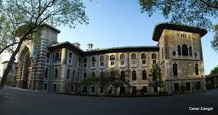
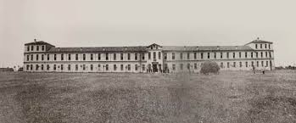
HE CHANGED SCHOOLS BECAUSE OF THE DEATH OF HIS FATHER

Slide 6
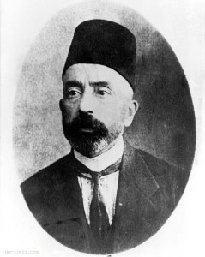
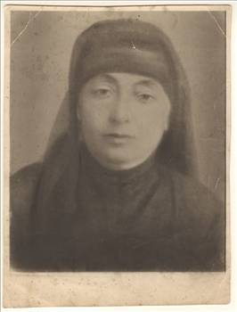
HIS FATHER IS ALBANIAN.
HIS MOTHER IS UZBEK.

Slide 7
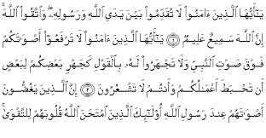
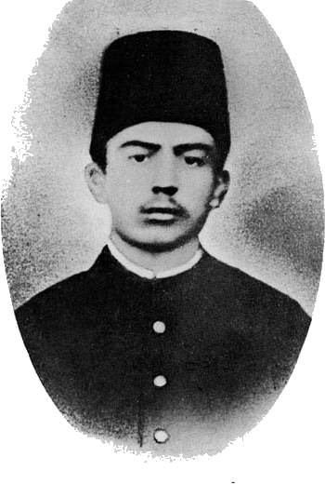
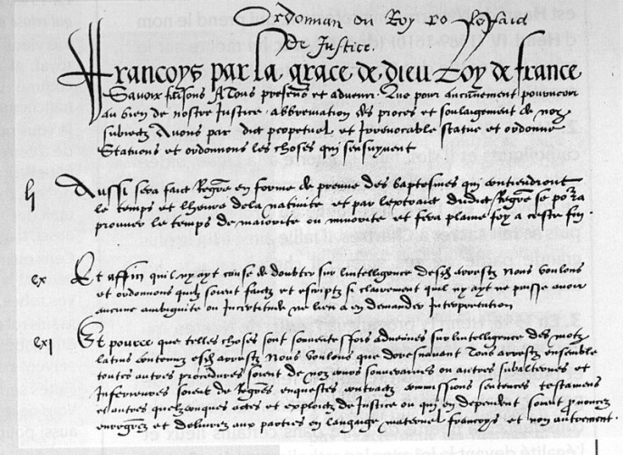
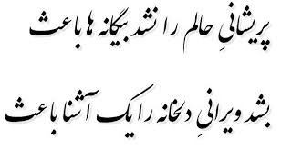
HE LEARNED ARABIC,PERSIAN AND FRENCH DURING HIS SCHOOL YEARS

Slide 8
HIS WORKS
Safahat (Phase) -1911
Süleymaniye Kürsüsünde -1912
Hakkın Sesleri (The Right Sounds) -1913
Fatih kürsüsünde -1914
Hatıralar (Memories ) -1917
Asım -1924
Gölgeler (shadows) -1933

Slide 9
STORY OF THE TURKISH NATIONAL ANTHEM
When Liberation war started our chief of staff (İsmet İnonu)says We must a march for turkish soldiers because if we write a march ,soldiers be enthusiastic,ambitious.
Therefore started award-winning competition and this competition ıs announced every public
724 poem is joined in the competition
End of competition 6 poem choosed then they gave up because didn't have the war spirit in this poems.
The person was Mehmet Akif who can write this poem. This thought was the whole assembly’s thought. Minister of education wrote a letter to M.Akif and said: It will not include an award for you. I mean it won’t be a competition. Then he accepted to write it.

Slide 10
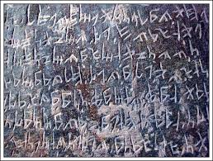
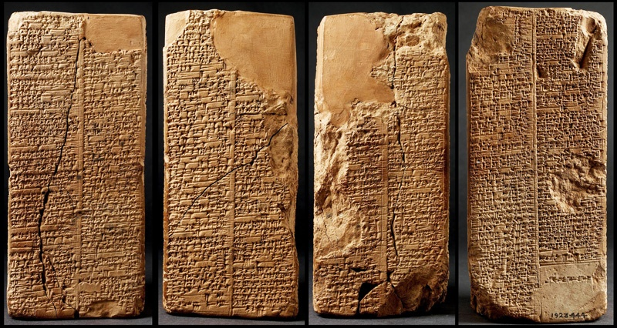
It was midnight when he was inspired, but he couldn’t find a pen. Then he wrote on the wall with a nail. Next day he wrote on a paper and sent to assembly.

Slide 11
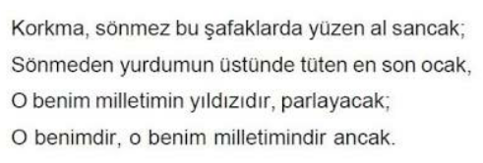
Poem includes 10 verses. 571 syllables (It symbolizes birth of our Prophet Hz.Muhammed) 1453 letters.( It symbolizes conquere of İstanbul)
K-O-R-K-M-A S-Ö-N-M-E-Z
LETTERS
KORK-MA
SÖN-MEZ
SYLLABLES
VERSE

Slide 12
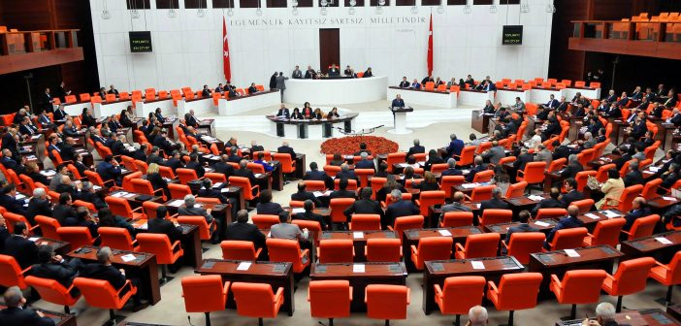
He was the winner and Minister of Education read the poem in Turkish Grand National Assembly

Slide 13
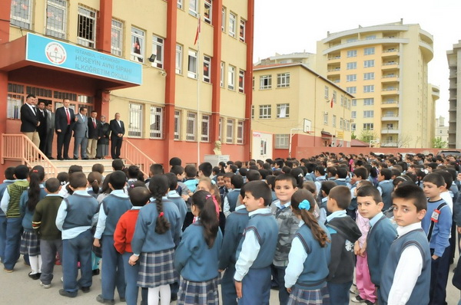
This poem symbolizes our independence , so we read this poem’s first and second verse every ceremonies.
For example at school we read beginning of the week I mean on Monday, and finishing of the week I mean on Friday we read again.

Slide 14
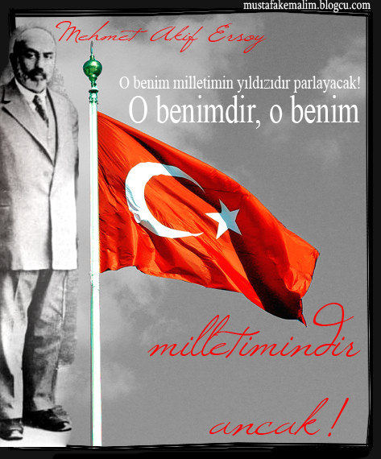

2011 years ıs accepted Mehmet Akif Ersoy years by Turkish Republic because this year is seventy fifth year of died Mehmet Akif and ninetieth year of the Turkish National Anthem accepted.

Slide 15
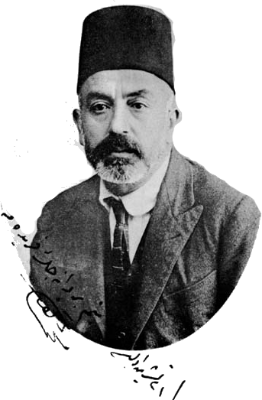
SOME OF HIS IMPORTANT SENTENCES
What makes the flag the blood on the flags.
Land,if there is somebody die for it, it is the country.
We pray for ; God not to get write again the Turkish National Anthem to this nation.

Slide 16
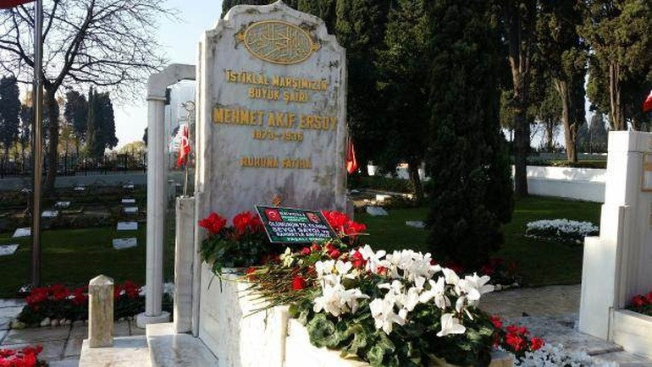
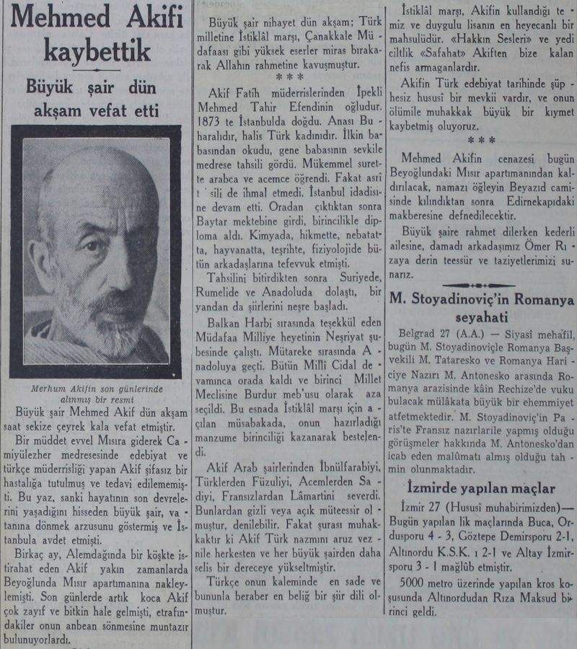
DATE OF DEATH: 27 DECEMBER 1936, İSTANBUL

